Slide 1

Explosives 101
Dr. Vilem Petr

Slide 2
Definitions
These definitions will be in concurrence with the Institute of Makers of Explosives (IME) and the International Society of Explosive Engineers (ISEE) as found in several publications printed by these two organizations.
  IME SLP-12 (www.ime.org)
  ISEE Blasters Handbook

Slide 3
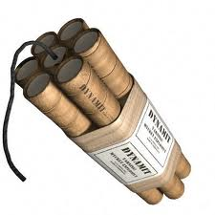
Definitions
Explosive
  Any chemical compound, mixture or device, the primary or common purpose of which is to function by explosion.

Slide 4
Definitions
Density - The mass of an explosive per unit of volume, usually expressed in grams per cubic centimeter or pounds per cubic foot
Diameter - The cross-sectional width of a borehole or an explosive cartridge (important in some non-ideal explosives, L:D)
Water Resistance - Ability of explosive to withstand the desensitizing effect of water penetration

Slide 5
Density and Diameter
DENSITY
DIAMETER
WATER
WATER
0.9
PRODUCT
PRODUCT
1.0
BOREHOLE
BOREHOLE

Slide 6
Bulk versus Packaged
BULK
PRODUCT
PACKAGED
PRODUCT
WATER
BOREHOLE
BOREHOLE

Slide 7
Definitions
Brisance - The shattering power of an explosive material as distinguished from its total work capacity.
Detonation Velocity (VOD) - The velocity at which a detonation progresses through an explosive.
  > speed of sound = detonation
  < speed of sound = deflagration or low order
  expressed in feet per second or meters per second

Slide 8
Definitions
Detonation Pressure
  The pressure produced in the reaction zone of a detonating explosive
  Various formulations for calculating Detonation Pressure
    2.5 x density x Detonation Velocity² x 10⁻⁶
  Important for product initiation or brisance applications

Slide 9
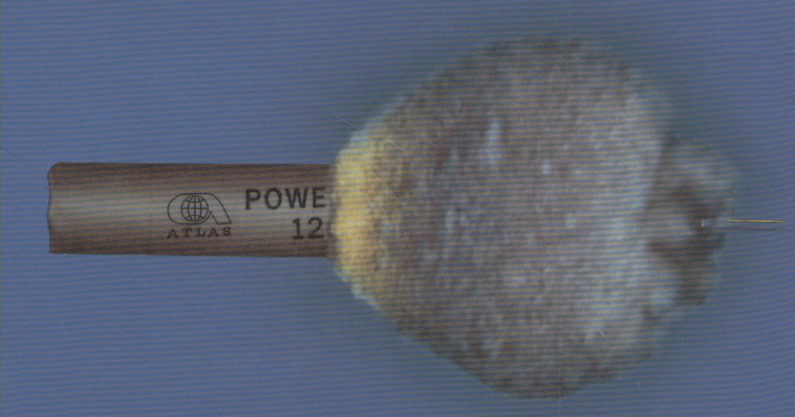
Detonation of Explosives
Detonation Moving Within the Explosive Charge
Detonation Front
Point of Detonation
Post Detonation Gases

Slide 10
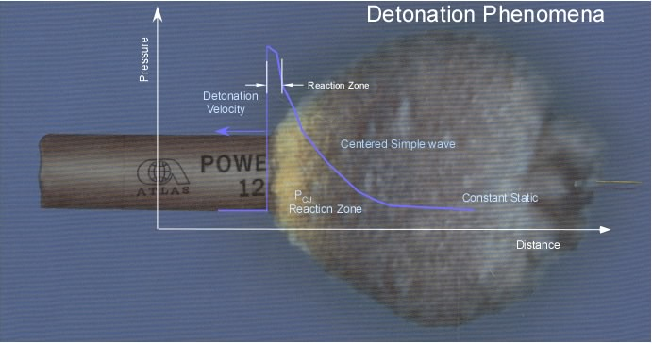

Slide 11
Definitions
Sensitiveness - A measure of an explosive's cartridge-to-cartridge propagating ability under certain test conditions. It is expressed as the distance through air at which a primed half-cartridge (donor) will detonate an unprimed half-cartridge (receptor).
Sensitivity - A physical characteristic of an explosive material classifying its ability to be initiated upon receiving an external impulse such as impact, shock, flame, friction or other influence which can cause explosive decomposition.

Slide 12
Sensitiveness & Sensitivity
Sensitiveness
Sensitivity
Detonator
Booster
PRODUCT
(Doner)
GAP
PRODUCT
PRODUCT
(Receptor)

Slide 13
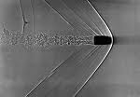



Explosive Sensitivity to Initiate
Initiate or stimulate the chemical reaction in the energetic material
Stimulation by:
    Shock
    Impact
    Heat
    Friction
    Electrostatic discharge
Shock Wave
Impact
Heat/ Friction
    Electrostatic discharge
Impact

Slide 14
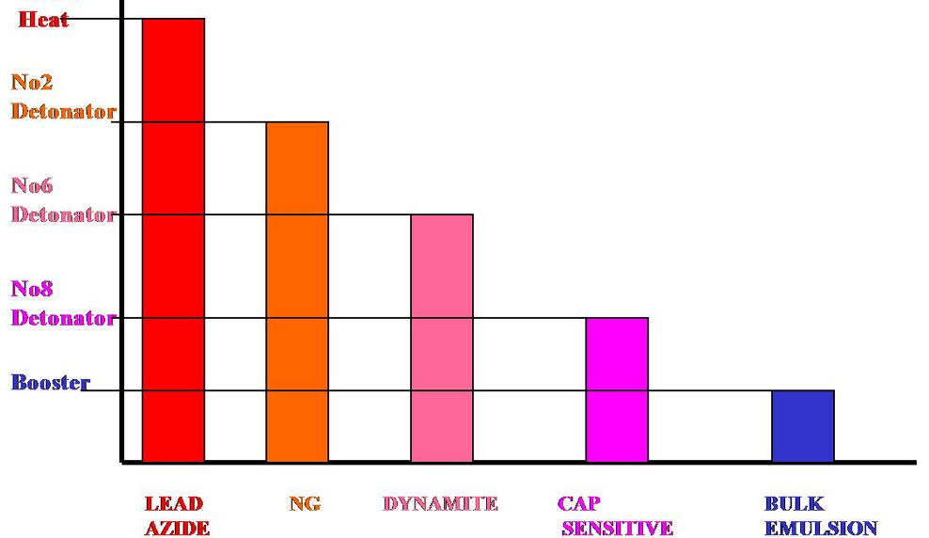
Explosive Sensitivity to Initiate
More sensitive
Less sensitive

Slide 15

Definitions
Munroe Effect - The concentration of explosive action through the use of a shaped charge.
Explosive
High powered
Jet of energy

Slide 16
Definitions
Oxygen Balance - The percentage of oxygen in an explosive material or ingredient thereof in excess of (+) or less than (-) that which is needed to produce ideal reaction products.
FUMES
Product
Borehole

Slide 17
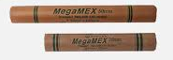
Definitions
Permissible Explosives (MSHA approved explosives)
  Explosives that are approved by the Mine Safety and Health Administration for use in gassy and dusty atmospheres. Permissible explosives must be used and stored in accordance with certain conditions specified by the Mine Safety and Health Administration (MSHA).

Slide 18
Definitions
Molecular Explosives (Ideal Explosives)
    PETN (pentaerythritol tetranitrate), TNT (trinitrotoluene)
Non-Ideal Explosives
    Usually consists of explosive products that require the interfacing of oxidizers and reducers
      ANFO (ammonium nitrate and fuel oil), water gels (ANFO, water and gelling agent), dynamites (NGs, nitrocellulose, oxidizing salts & fuel ingredients)

Slide 19
INITIATION TO STEADY STATE VELOCITY COMPARISONS
30,000
26,000 FEET/SECOND
15,000
5.5 Pound Pentolite Charge
30,000
18,000 - 21,000 FEET/SECOND
15,000
5 pound ANFO Charge (no balloons)

Slide 20
Definitions
Electric Detonator - A detonator designed for, and capable of, initiation by means of an electric current.
Electronic Detonator - A detonator that utilizes stored electrical energy as a means of powering an electronic timing delay element/module and that provides initiation energy for firing the base charge.

Slide 21
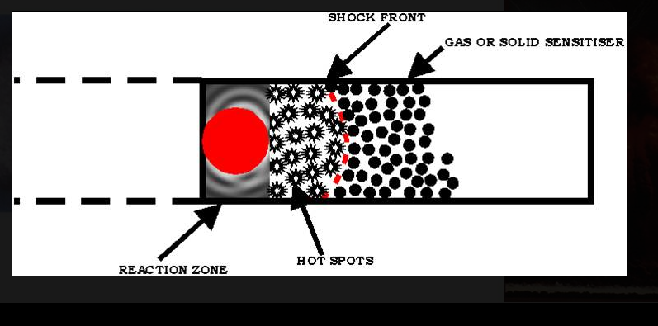

Definitions
An Explosion is a chemical reaction in a substance which converts the original material into a gas at very high temperature (over 3,000º C) and pressure (50,000 atm). The process occurs with extreme rapidity and evolving a great deal of heat.
Notes:
Temperature in product gasses

Slide 22





Explosive Energy

Slide 23
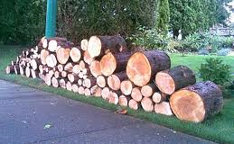



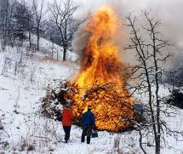
Explosives
Propellant and Explosive Fire Triangles
Wood
ANFO
Fuel
(Wood)
Fuel
(Oil)
Oxygen
(ammonium nitrate)
Oxygen
(Air)
Initiation
(Flame)
Initiation
(Sparks)
The reaction in an explosion is so rapid that it is impossible for ambient air to flow into the reaction zone fast enough to support its propagation.
The ratio of oxidizer to fuel in an explosive is referred to as its Oxygen balance.
Notes:
When wood burns, it is also a chemical process resulting in heat and pressure but it is much lower than an explosion. Some explosions take place in three milliseconds, producing sudden pressure. For a fire we need three things: fuel, oxygen and initiation, the same is true of an explosion. Any explosive must contain its own oxygen to be defined as an explosives. It cannot draw its oxygen from air, as wood does when it burns. An explosive must be sensitive to initiation by heat or pressure(shock). In the production of an explosive, fuel is mixed with oxygen. For example, gasoline itself is not explosive, but gasoline vapors are.

Slide 24
Types of Explosives: Chemical Make-Up
Energetic Materials
DETONATION
DEFRAGRATION
High Explosives
Low Explosives
Primary
Explosives
Secondary
Explosives
Tertiary
Explosives
Propellants
Pyrotechnics
Single
Explosives
Composite
Explosives
Gasoline
Rocket Fuel
Thermite
Black Powder
Delay Compositions
Igniter Compositions
Lead Azide
Mercury Fulminate
Silver Azide
Nitroglycerin
Nitroglycol
Nitromethane
RDX / HMX
TNT
Pentolite
Dynamites
Composition B
ANFO
Slurries
Ammonium Nitrate
Mononitrotoluene
Ammonium Perchlorate

Slide 25
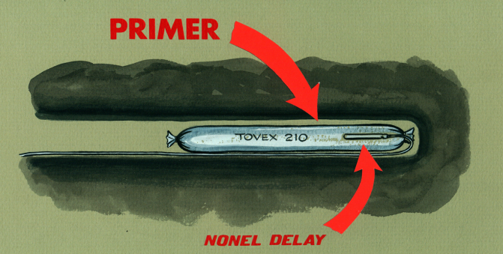
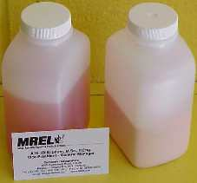
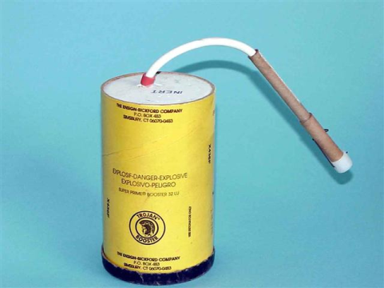
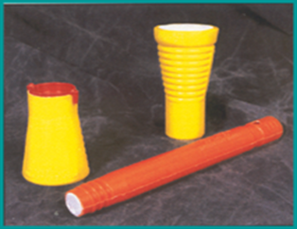
Types of Explosives: Relationships
Explosive Materials
Low Explosives
High Explosives
Accessories
Deflagration-Detonation Train (DDT)
Primary
Explosives
Secondary
Explosives
Main Charges
Boosters
Detonator Sensitive
Non-Detonator Sensitive

Slide 26
Definitions
Blasting Cap - A detonator that is initiated by a safety fuse
Booster - An explosive charge, usually of high strength and high detonation velocity, used to improve the initiation of less sensitive explosive materials
Detonator - Any device containing any initiating or primary explosive that is used for initiating detonation. A detonator may not contain more than 10 g of total explosives by weight, excluding ignition or delay charges. The term includes, but Is not limited to, electric blasting caps of instantaneous and delay types, blasting caps for use with safety fuses, detonating cord delay connectors, and nonelectric instantaneous and delay blasting caps that use detonating cord, shock tube, or any other replacement for electric leg-wires.

Slide 27
Definitions
Detonator (Cap) Sensitivity
The sensitivity of an explosive to initiation by a detonator. An explosive material is considered to be detonator sensitive if it detonates with an IME No. 8 Test Detonator

Slide 28
Definitions
Cartridge - An individual closed shell, bag, or tube of circular cross section containing explosive material
Delay Detonator - An electric or nonelectric detonator used to introduce a predetermined lapse of time between the application of a firing signal and the detonation of the base charge
Deflagration - An explosive reaction such as a rapid combustion that moves through an explosive material at a velocity less than the speed of sound in the material
Date-Shift Code - A code applied by manufacturers to the outside shipping containers, and, in many instances, to the immediate containers of explosive materials to aid in their identification and tracing

Slide 29
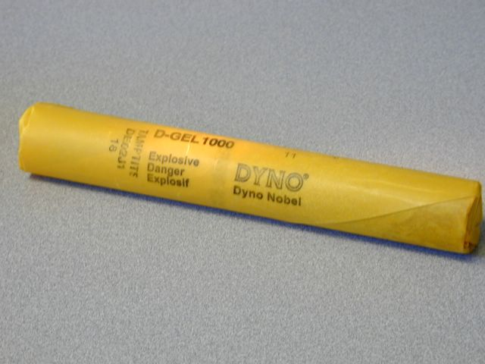
Cartridge with Date Shift Code

Slide 30
Definitions
Detonating Cord - A flexible cord containing a center core of high explosive and used to initiate other explosives
Detonating Cord Trunkline - The line of detonating cord that is used to connect and initiate other lines of detonating cord
Detonation - An explosive reaction that moves through an explosive material at a velocity greater than the speed of sound in the material
Detonation Pressure - The pressure produced in the reaction zone of a detonating explosive

Slide 31

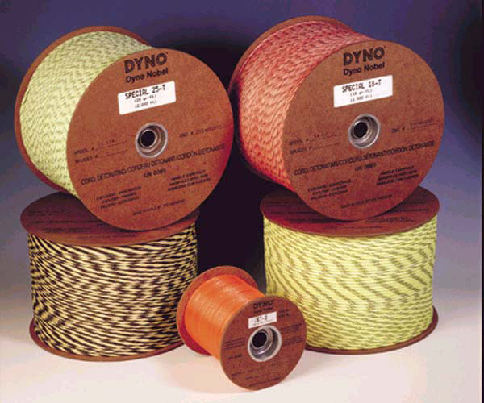
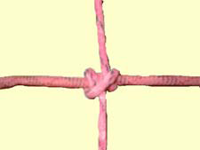
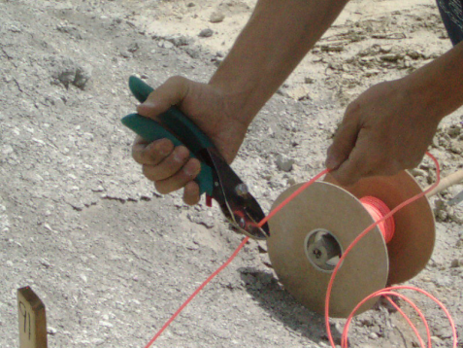
Detonating Cord - Trunkline

Slide 32
Definitions
Emulsion - An explosive material containing a suspension of small spheres of liquid oxidizers dissolved in water droplets in a second liquid surrounded by an immiscible fuel
Fly-rock - Rocks propelled from the blast area by the force of an explosion
Inhabited Building - A building regularly occupied in whole or part as a habitation for human beings, or any other structure where people are accustomed to assemble, except any building or structure occupied in connection with the manufacture, transportation, storage, or use of explosive materials
Initiation - The act of causing an explosive material to detonate or deflagrate

Slide 33
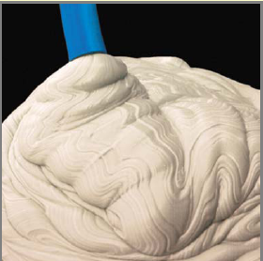
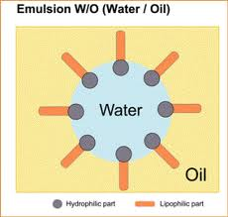
Emulsion

Slide 34
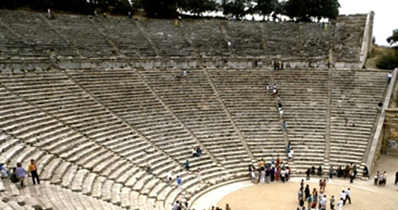
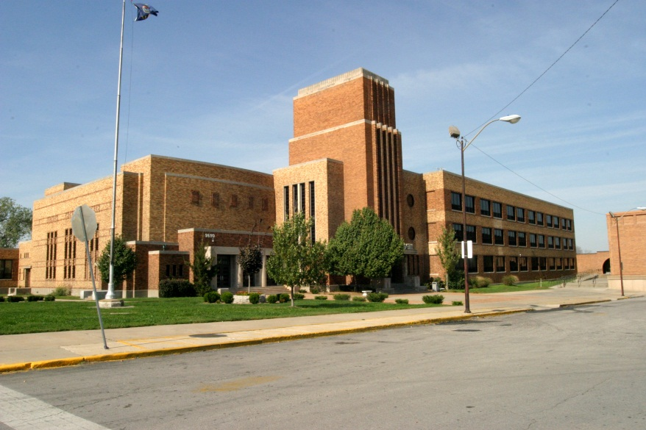

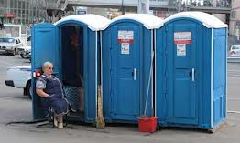
Inhabited Building

Slide 35
Definitions
Magazine - Any building, structure, or container, other than an explosives manufacturing building, approved for the storage of explosive material
Misfire - A blast that fails to detonate completely after an attempt at initiation; also the explosive material itself that failed to detonate as planned
Natural Barricade - Natural features of the ground, such as hills, or timber of sufficient density that the surrounding exposures that require protection cannot be seen from the magazine when the trees are bare of leaves
Non-Sparking Metal - A metal that will not produce a spark when struck with other tools, rock, or hard surfaces

Slide 36
Definitions
Barricaded - The effective screening of a building containing explosives from a magazine or other building, railway, or highway by a natural or an artificial barrier. A straight line from the top of any sidewall of the building containing explosives to the eave line of any magazine or other building or to a point 12 ft above the center of a railway or highway shall pass through such barrier.
Safety Standard - Suggested precautions relative to the safety practices to be employed in the manufacture, transportation, storage, handling, and use of explosive materials
Shelf Life - The length of time of storage during which an explosive material retains adequate performance

Slide 37
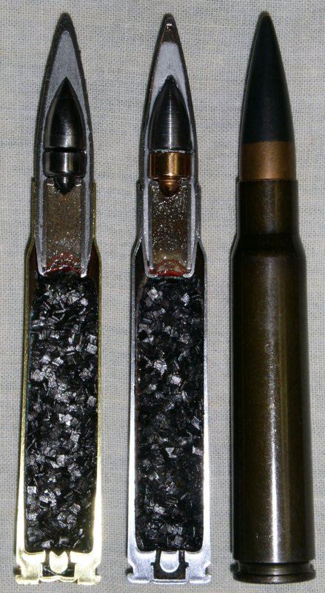
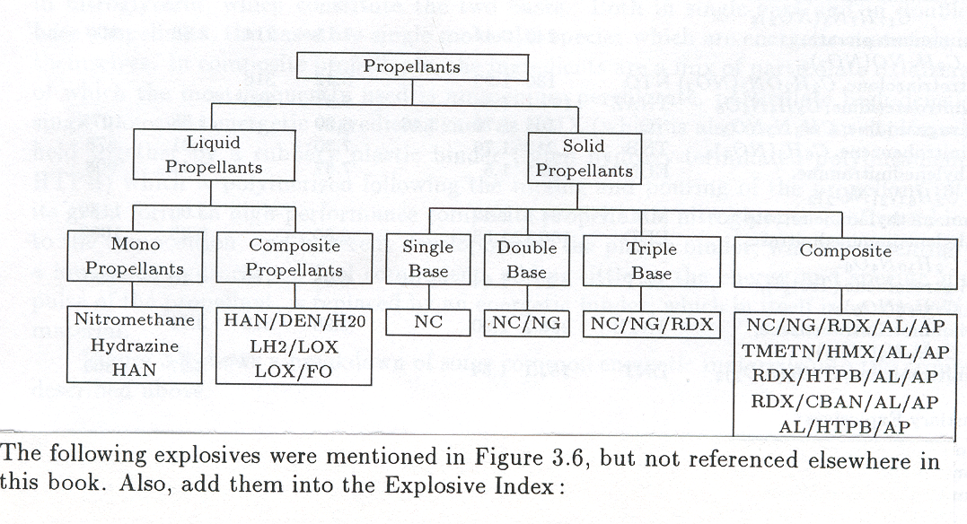
Propellants
Propellants
Liquid
Propellants
Solid
Propellants
Mono
Propellants
Composite
Propellants
Single
Base
Double
Base
Triple
Base
Composite
NOTE: most sensitive low explosive is photo-flash powder, followed by black powder, Pyrodex, and various types of smokeless powder
The danger: the unwitting spillage of black powder on the threads of a length of pipe during the fabrication of a pipe bomb has ended many a would-be bomber’s life when he/she attempted to screw the end cap onto the pipe. The friction induced by the action of the grading threads on the pipe and end cap have produced the little energy required to initiate the powder main charge

Slide 38
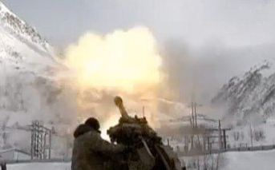
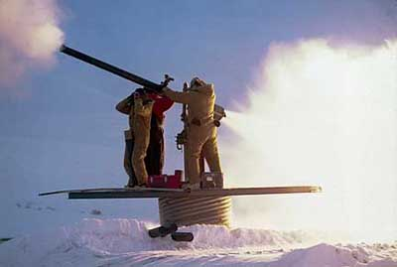
Propellants Delivery HE for Avalanches
YES
NO

Slide 39
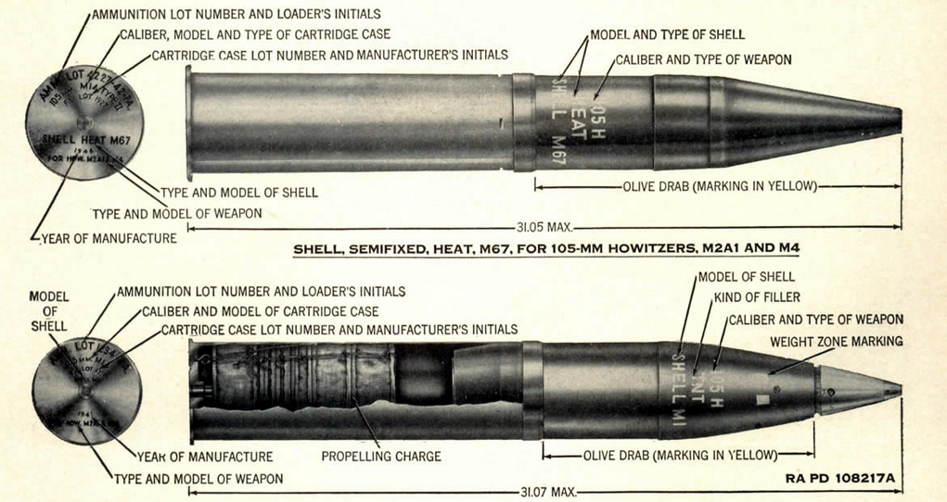
M101 Howitzer
The 105 mm M2A1 (M101A1) howitzer was the standard light field howitzer for the United States in World War II, seeing action in both European and Pacific theaters. Entering production in 1941, it quickly entered the war against the Imperial Japanese Army in the Pacific, where it gained a reputation for its accuracy and powerful punch. The M101A1 fired 105 mm high explosive (HE) semi-fixed ammunition and had a range of 11,200 metres (12,200 yd), making it suitable for supporting infantry.

Slide 40

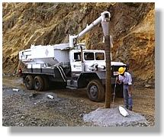
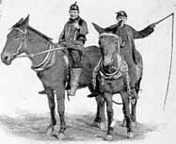
Delivery
ANFO BEING BAGGED
ANFO BULK TRUCK
ANFO DELIVERY (Dr. Petr)

Slide 41




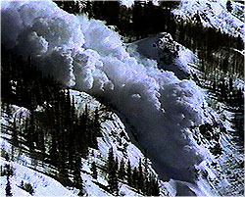
Delivery

Slide 42

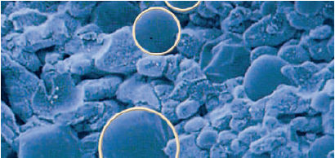
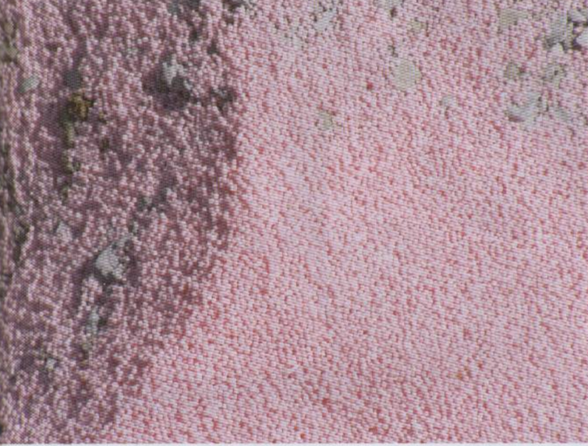
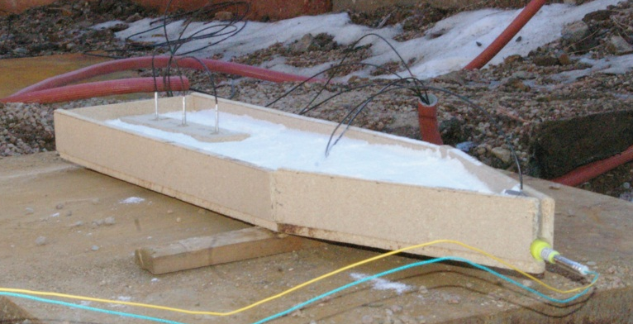
Tertiary Explosives: Blasting Agents
Ammonium Nitrate and Fuel Oil (ANFO)
Manufacturers: Austin Powder, Dyno Nobel, Mining Services International (MSI), Orica, Slurry Explosives Corporation (SEC)
Brand names: Austinite, Iremix, Irepak, Pellite, Anformet, Sulfamax, Lomex, Pellite, Pakamex, SEC 500, ANFO HD series
Sensitivity: Only non-detonator sensitive
VOD range: 8,000 to 15,000 ft/s
Packaging:
  Packaged and bulk
  Multiwalled paper bags-50 pounds
  Cylindrical, woven polyethylene bags up to 50 lbs
  Polyethylene bags 25 and 50 pounds
ANFO
Booster
Detonator

Slide 43
Dynamite
Nitroglycerin
  Discovered by Italian chemist doing pharmaceutical research
Combined with dirt (diatomaceous earth) by Alfred Nobel
Dynamite - the first high explosive
Nobel developed initiator to shoot the dynamite

Slide 44
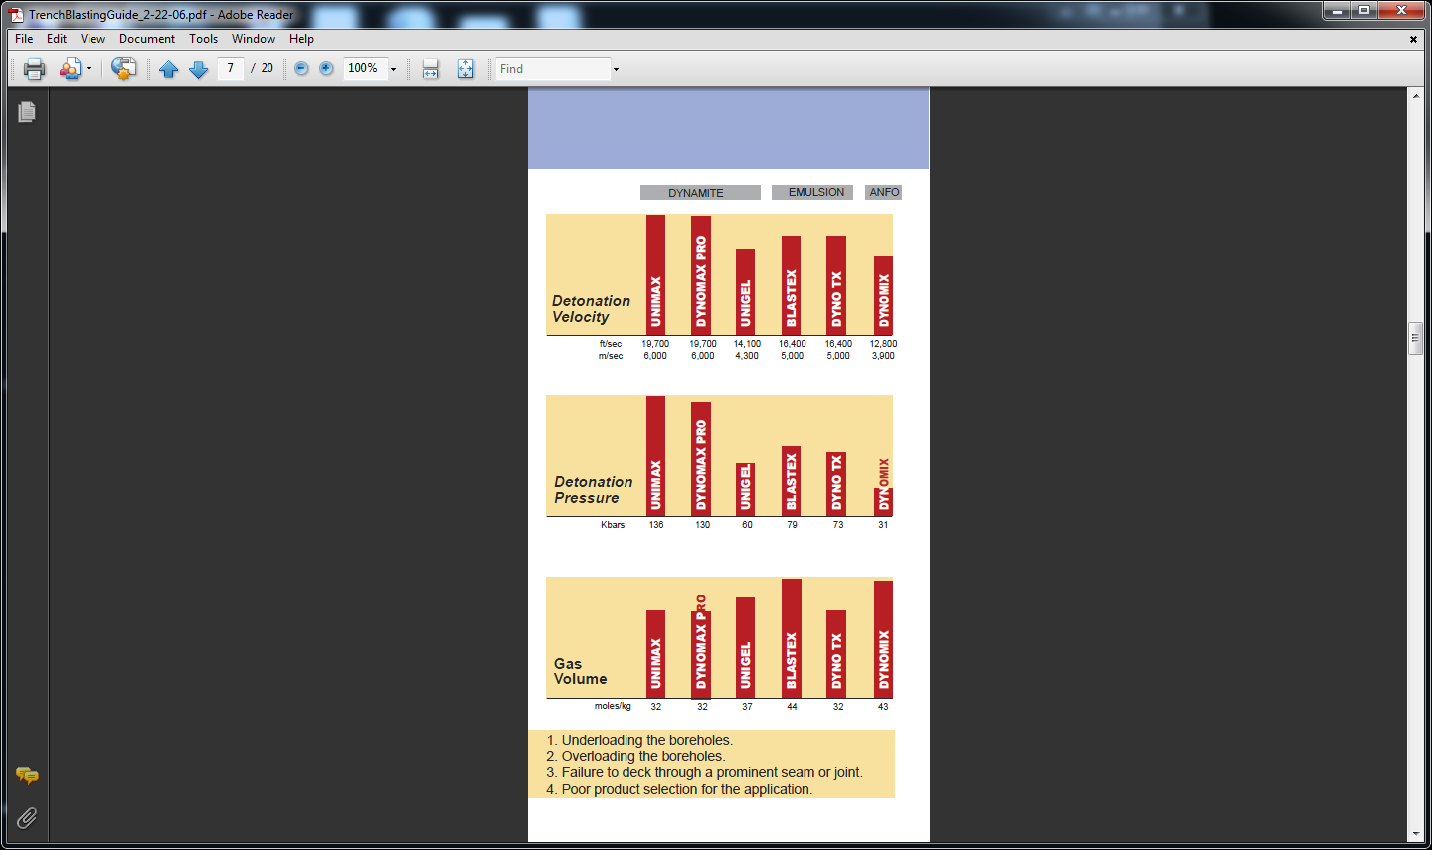
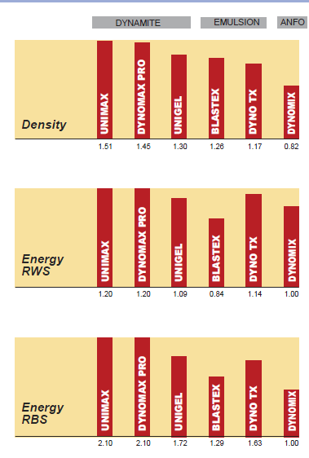
Dynamite vs. Other Explosives
FOUR REASONS FOR POOR BLASTING RESULTS

Slide 45
Temperature Ratings Summary - 1 hr.
HNS/HTX
Detonating Cord, Shaped Charges
PSF
Detonating Cord, Shaped Charges
HMX
Detonating Cord, Shaped Charges
RDX
Det. Cord, Shaped Charges
PETN
HEGS
0
100
200
300
400
500
Temperature (°F)

Slide 46
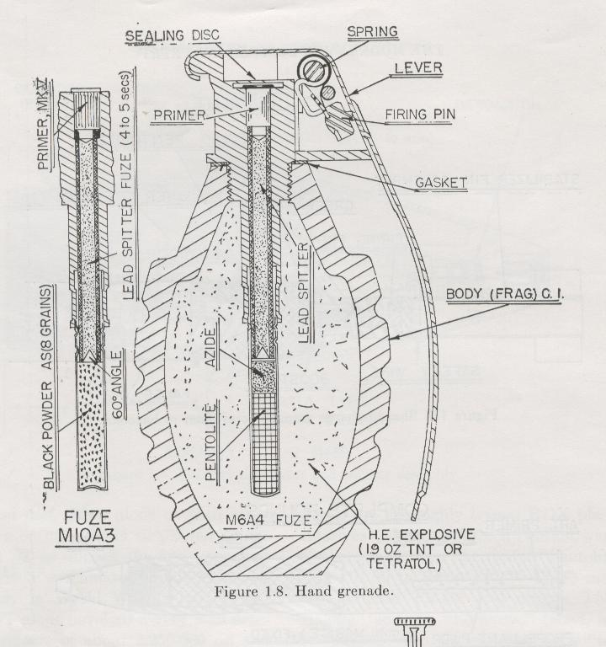
Characteristics of PRIMARY EXPLOSIVES
Undergo a deflagration to detonation transition (DDT)
Are the most sensitive type of high explosives
Are classified as a high explosives
Have less energy than secondary explosives
Are used in detonators and initiation systems
Examples: Lead azide, lead styphnate and mercury fulminate
Primary Explosives
Primer

Slide 47
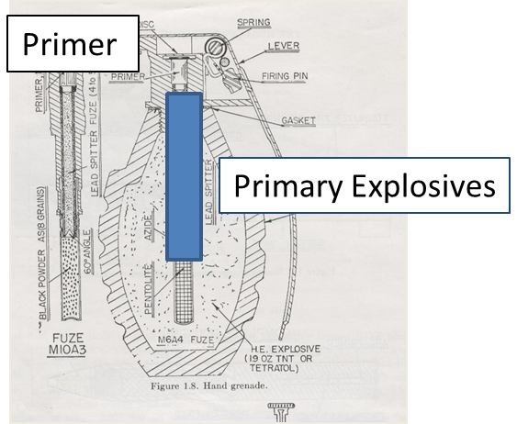
Characteristics of SECONDARY EXPLOSIVES
Are more powerful than primary explosives
Are less sensitive than primary explosives
Require a booster and/or detonator to function
Are used in large quantities than primary explosives
Examples: ANFO, Dynamite, water gels, emulsion explosives, and boosters
Secondary Explosives

Slide 48
Explosive Performance
How well the explosive works or how well does not work
High-Order: has had completed burning or initiation of the explosives at its maximum velocity
Low-Order: is one that has had incomplete burning of explosive at less than maximum velocity
Examples of Low-Order:
    Old, deteriorated explosives, poor contact between the explosive and the initiator, an insufficient initiator, premature failure (rupture)

